Slide 1
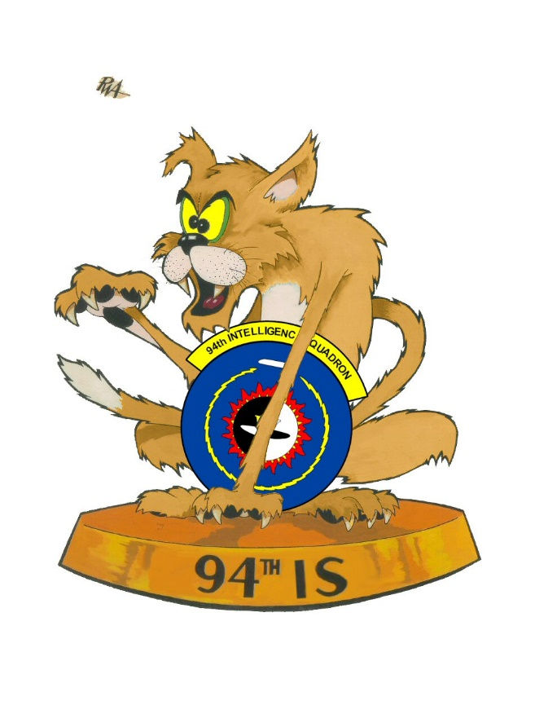
94th Intelligence Squadron Heritage Day
10-11 May 2018
Ft George G. Meade, MD
Please join us on 10 May, 1200-1500, for a tour of the 94th IS Heritage Room, command Mission Brief, and presentation from the POW/MIA Accountability Agency. A no host dinner is being planned that evening.
11 May, 1030-1500 for a guided tour of the NSA Cryptologic Museum followed by BBQ and festivities at Burba Lake on Fort Meade.
Please reply to any of the POCs so we can begin the security clearance process to get you access to the NSA Campus.
Please RSVP by 26 April 2018
POCs:
MSgt Cole Davis
cole.davis@us.af.mil
(301) 688-5520
TSgt Nathan Glickler
nathan.glickler@us.af.mil
MSgt Dameon Launert
dameon.launert@us.af.mil

Slide 2
94th Intelligence Squadron Heritage Day
10-11 May 2018
Ft George G. Meade, MD
There are numerous hotels in the area; prices typically range from $85 - $105/night. Within 5 minutes from Ft. Meade are the Courtyard by Marriot Ft. Meade (with a group rate of $99/night) and the Knights Inn Laurel (at $55/night).
If you can and prefer to stay on Ft. Meade, there is the Candlewood Suites/IHG Army Hotels at $89/night.
Please bear in mind that Maryland has a 13% Sales and Lodging tax that may not be included in the advertised room rates.
Please RSVP by 26 April 2018
POCs:
MSgt Cole Davis
cole.davis@us.af.mil
(301) 688-5520
TSgt Nathan Glickler
nathan.glickler@us.af.mil
MSgt Dameon Launert
dameon.launert@us.af.mil

